Slide 1

Now available for individuals and businesses
Notes:
Think of GitHub Copilot as your AI pair programmer

Slide 2



Give your developers a huge advantage
Increase developer productivity
And satisfaction by focusing on real problems
Accelerate innovation
Prototype & innovate more rapidly
Bridge skill gaps
Learn new languages and techniques
Notes:
Alternate titles: Give Your Developers the Advantage of AI
GitHub Copilot improves developer productivity and happiness, reducing disruptions, improving flow and increasing the amount of time a developer spends doing satisfying work.
Accelerate Software Development & Delivery & Improve Organization Efficiency
Increase developer productivity and satisfaction: Copilot supports developer satisfaction and thus productivity by helping them focus on solving real problems. By providing suggestions and boiler-plate code, developers can cut down on development time and create more consistent code. Adopting GitHub Copilot has secondary effects on improving job satisfaction, improving retention.
Accelerate Innovation: Using Copilot, teams can prototype new ideas more rapidly and innovate faster. As an additional benefit, companies that adopt the latest technologies can attract new talent by investing in the best-in-class tools as they seek to modernize their development processes.
Bridge skill gaps: GitHub Copilot helps professionals learn and practice new languages faster. For employers in demand of talented developers with niche programming skills (like COBOL), GitHub Copilot can help companies train and grow employees with those skills faster.

Slide 3

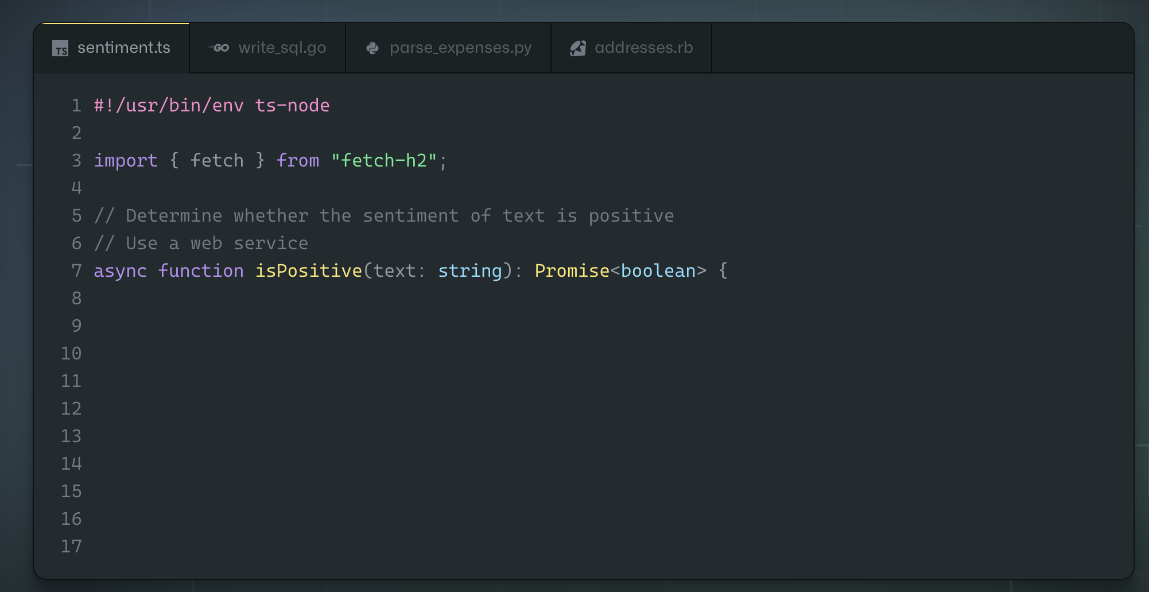
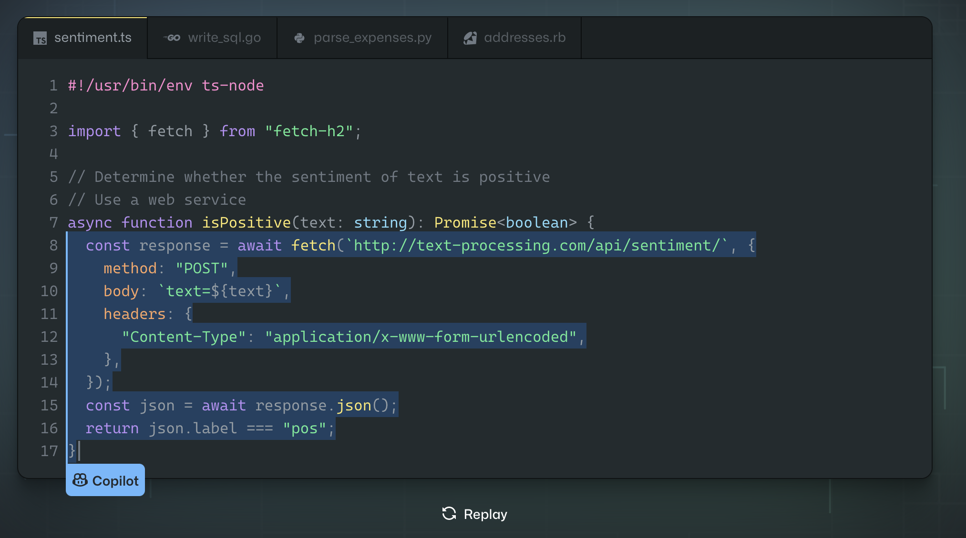
Offers code suggestions, contextualized to your project
Convert comments to code
Autofill for repetitive code
Show alternatives
Notes:
Uses the context you’ve provided and synthesizes code to match
Convert comments to code: describe the logic you want, and let GitHub Copilot assemble the code for you
Autofill for repetitive code: quickly produces boilerplate and fills in repetitive code patterns
Show alternatives: show a list of solutions to use as provided, or edit to meet your needs
Test Case Generation: create test cases for existing code
Code Documentation: Create formal documentation for existing code.
Code explanation: Explains in human terms the function and flow of code.

Slide 4
96%
88%
74%
say they are faster with repetitive tasks
say they are more productive
focus on more satisfying work
Notes:
Data from https://github.blog/2022-09-07-research-quantifying-github-copilots-impact-on-developer-productivity-and-happiness/
After early observations and interviews with users, we surveyed more than 2,000 developers to learn at scale about their experience using GitHub Copilot.
The numbers here are from three categories of findings …
Efficiency and flow (96% say they are faster with repetitive tasks)
Perceived Productivity (88% say they are more productive)
Satisfaction and Well-being (75% focus on more satisfying work)

Slide 5
Developers using GitHub Copilot…
88%
…have faster completion
87%
…exert less mental effort on repetitive tasks
77%
…spend less time searching
73%
…stay more in the flow
60%
…are more fulfilled with [their] job
59%
…are less frustrated when coding
Notes:
Here’s some more details from our findings from our research.
The first four (88%, 87%, 77%, and 73% are from the Efficiency and Flow section.
The last two (60% and 59%) are from the Satisfaction and Well-being section.
All stats from https://github.blog/2022-09-07-research-quantifying-github-copilots-impact-on-developer-productivity-and-happiness/

Slide 6
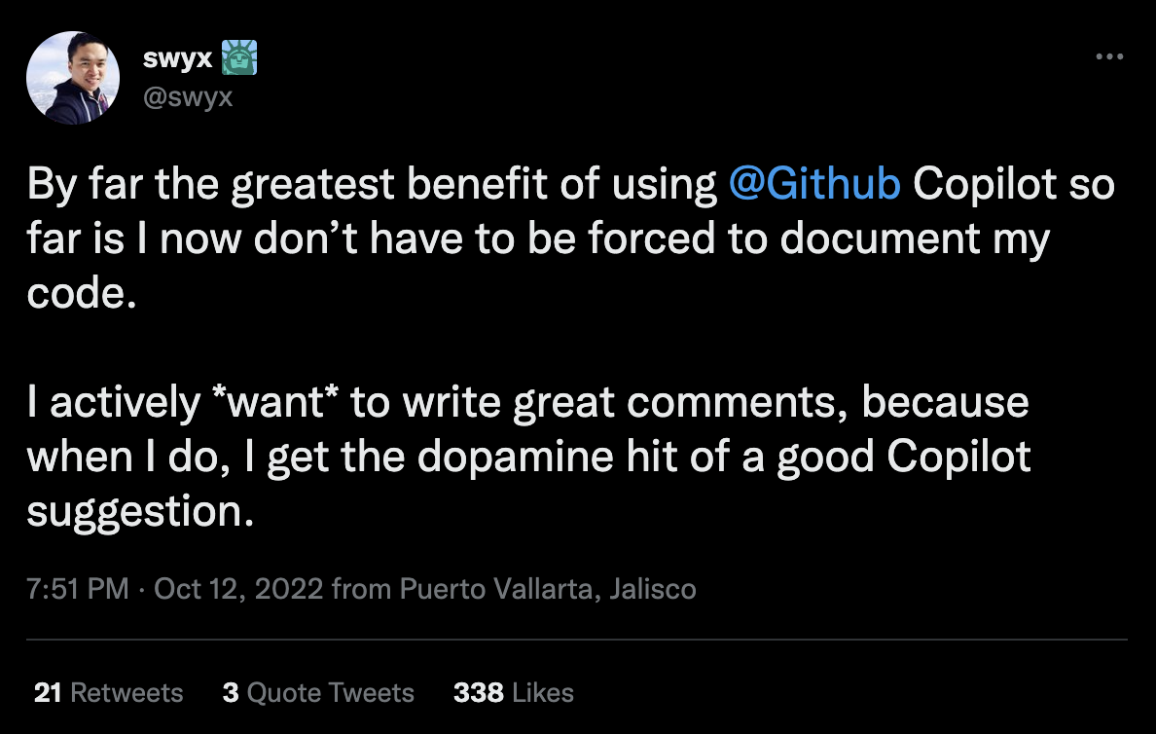
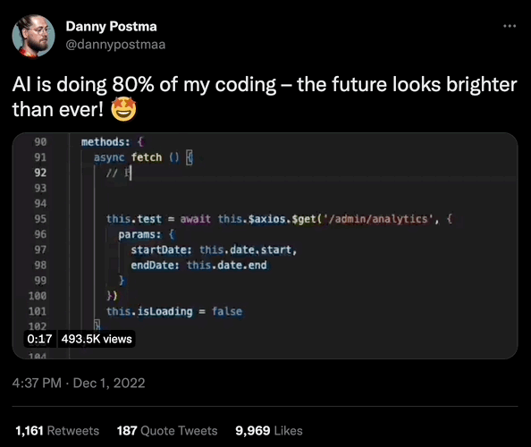
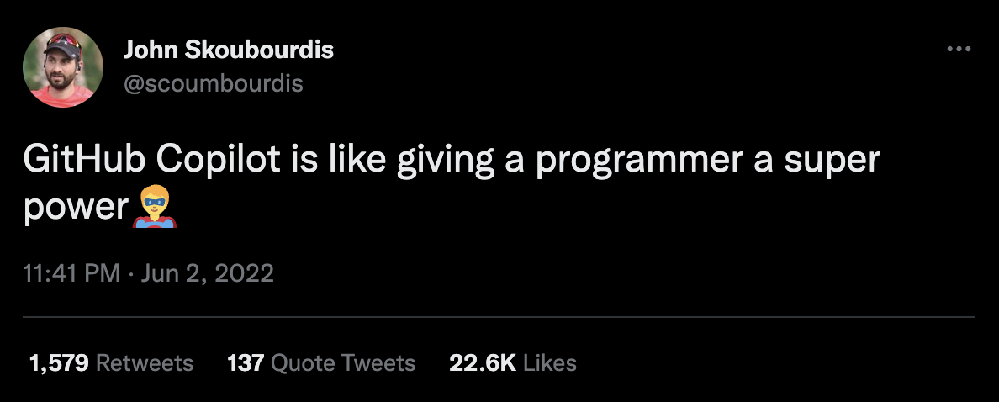
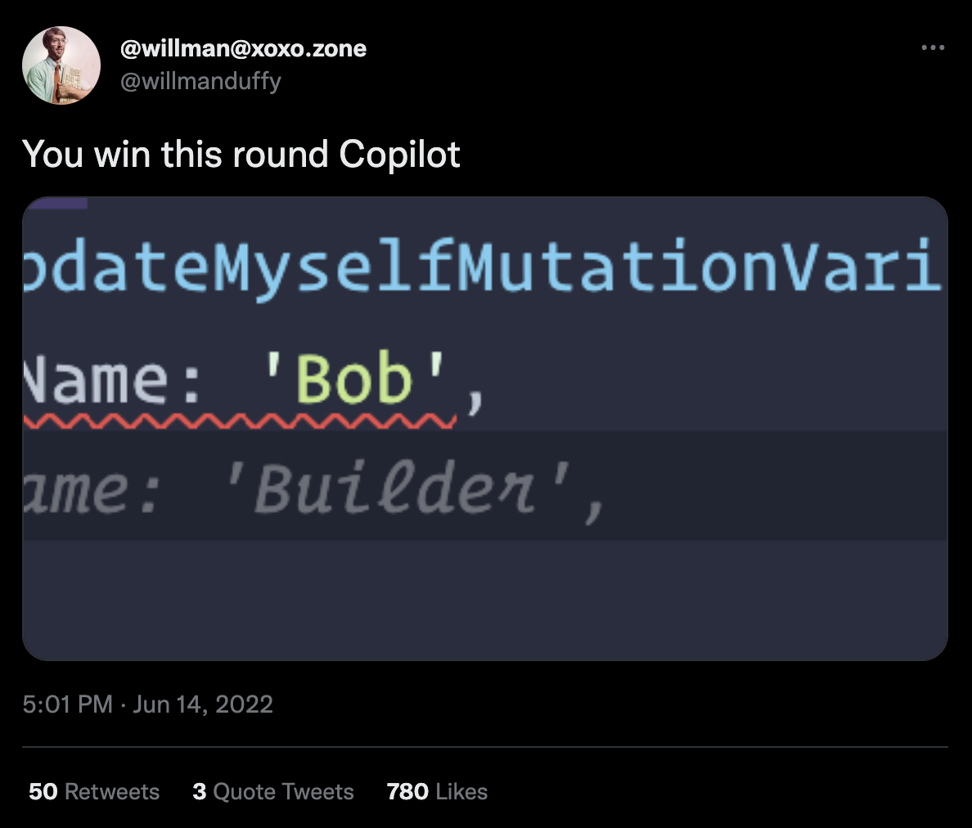
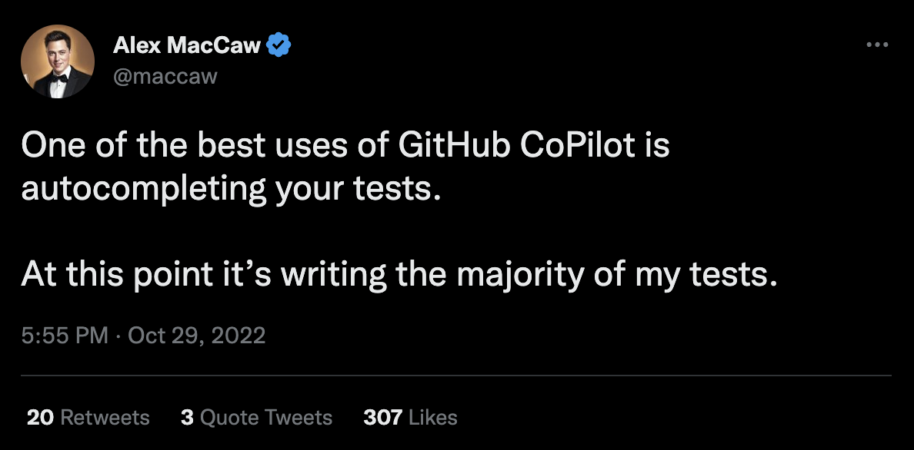
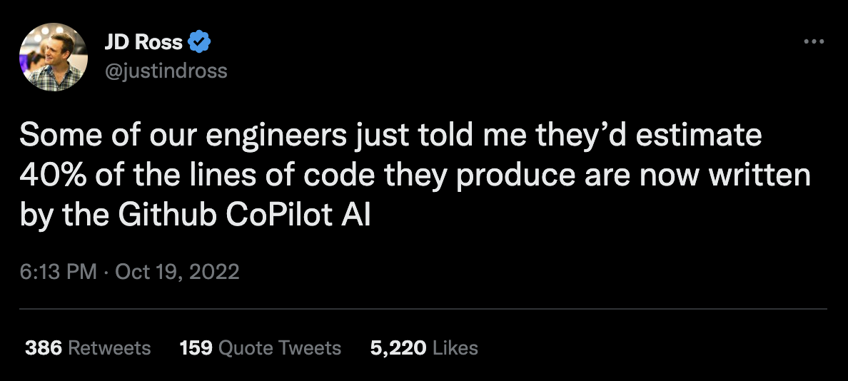
Notes:
Here’s a few quotes from folks on Twitter (quotes are “as-is” and were not paid or sourced by GitHub).
Links for tweets (left to right, top to bottom):
https://twitter.com/scoumbourdis/status/1532613467567423492
https://twitter.com/swyx/status/1580390673936658432
https://twitter.com/dannypostmaa/status/1598476315707191296
https://twitter.com/maccaw/status/1586522019927048193
https://twitter.com/willmanduffy/status/1536861352521781248
https://twitter.com/justindross/status/1582902733065289728

Slide 7
Keep flying with your favorite editor
VS Code
GitHub Codespaces
Visual Studio (Windows)
JetBrains IDEs
Neovim
Notes:
GitHub Copilot is available where you want it. On your desktop using popular IDEs or in your browser using GitHub Codespaces.

Slide 8
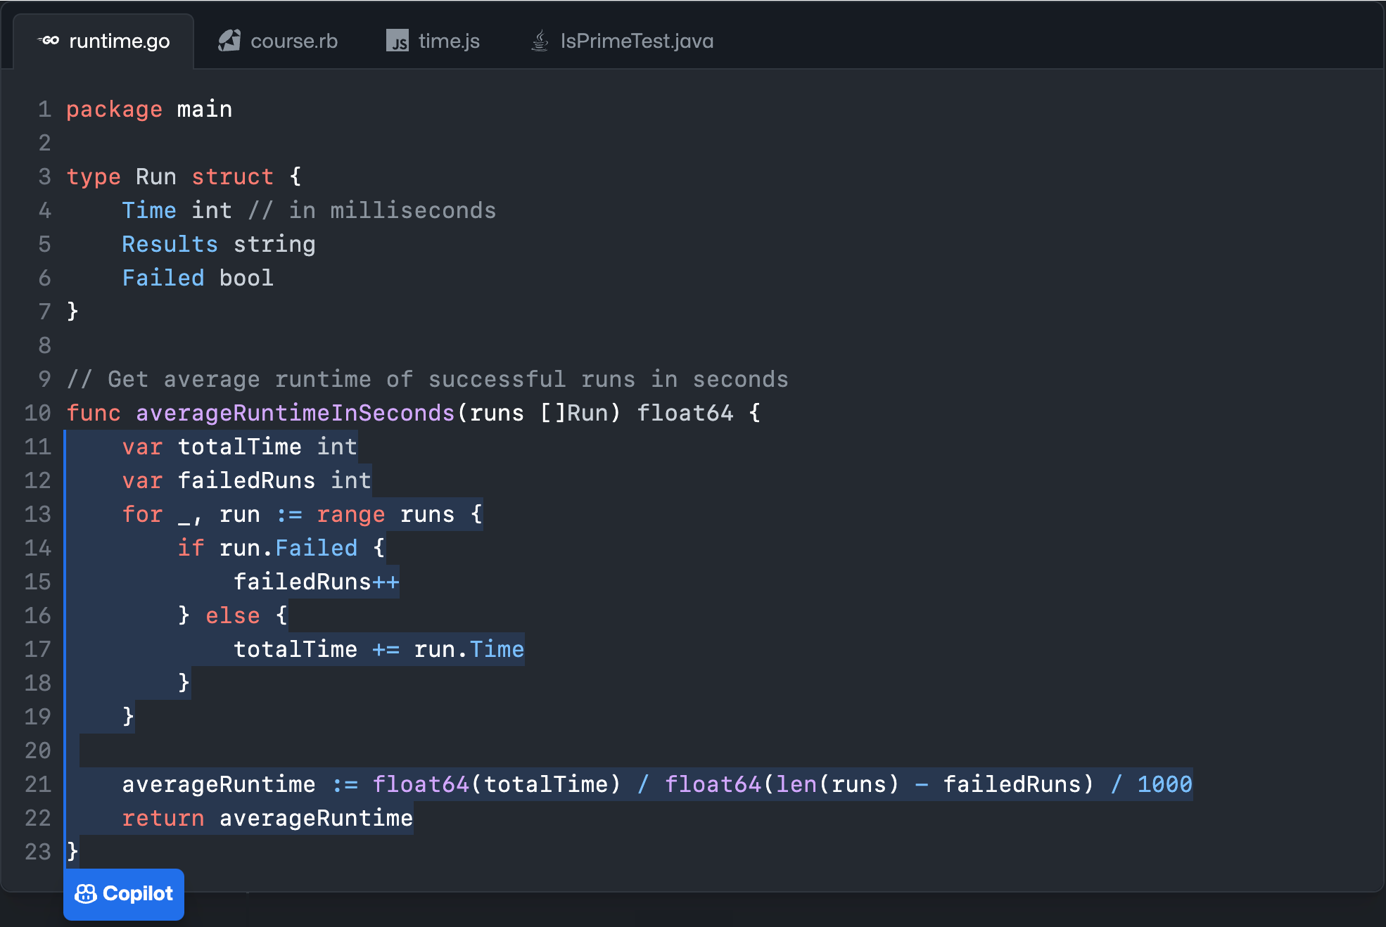



Once enabled…
Context
Suggestions
OpenAI Codex
Notes:
Slide is animated
Here’s your code editor with Copilot enabled. (Click)
Your editor provides context to Copilot.
GitHub Copilot uses the OpenAI Codex Model and GPT-3 behind the scenes.
It returns suggestions to your editor where you choose what to accept or ignore.
Talking points
GitHub Copilot provides context from local files. It’s not attached to a repository. The file being edited could be hosted on GitHub or in any other repo, but it’s not a requirement.
GitHub Copilot shares data in an ephemeral way. It’s shared just long enough for GitHub Copilot to provide a suggestion. We do not take that code and put it back into the data model for suggestions.
GitHub Copilot uses a transformative model. Think of something like Google Translate. You put in some words in English, translate it into another language. Google Translate hasn’t seen that exact sentence before necessarily and translated into that new language. Google Translate understands the semantics; the definition of the words, language patterns, whether there is a subject or direct object, and based upon that input, suggests an appropriate result. You could think about GitHub Copilot as a translation tool.
GitHub Copilot will write novel code. But having said that, GitHub Copilot is looking for language patterns and it learns language patterns. There may be times where a particular line, or a few lines of code, appears in thousands and thousands of repositories. That starts to look like a language pattern, rather than its own unique piece of code. In those cases, GitHub Copilot will occasionally regurgitate what it thinks is a pattern as it’s seen it so many times. For that case, the GitHub Copilot team created an IP filter. GitHub Copilot includes a filter which detects code suggestions matching public code on GitHub. You can choose to enable or disable the filter. When the filter is enabled, GitHub Copilot checks code suggestions with their surrounding code of about 150 characters against public code on GitHub. If there is a match or near match, the suggestion will not be shown to you. This is done on the Service side of GitHub Copilot,
Additional talking points if pressed
Why 150 characters? Some of it is a judgement call. You don’t want it so short that you’re comparing a simple if statement, but you want to block anything that would be meaningful. 150 characters on average is about two lines worth of code. It’s a good length to detect if there are a couple of lines of similarity. Based on research, GitHub also found that 150 characters, based on the number of suggestions presented, and accepted, was about the same as it was without the IP being thrown, i.e. the Developer Experience did not deteriorate.
GitHub Copilot is there to enhance your day-to-day work. Accountants don’t do calculations in their head all day. They have calculators and tools to enable them to be more productive. Think of Copilot as the evolution of tooling and Developer Experience for us as developers.

Slide 9
For Individuals
Plugs right into your editor
Turns natural language prompts into code
Offers multi-line function suggestions
Speeds up test generation
Blocks suggestions matching public code
For Business
Everything included in Copilot for Individuals, plus
Simple license management
Organization-wide policy management
Industry-leading privacy
Notes:
GitHub Copilot is available today in two paid offerings today.
$10 a month or $100 a year for individuals.
$19 per user, per month, for qualified GitHub Enterprise Cloud businesses.

Slide 10



Individual controls
Turn it on and off
Right from your IDE
You can opt-out of telemetry
Share your code snippets (or don’t)
Filtering Public code matches
Allow or block suggestions
Notes:
As a developer, you’re in control when you use GitHub Copilot.
You can enable it as you desire in your IDE at any time.
You can opt-out of telemetry sharing with GitHub and can block suggestions from public code.

Slide 11



Business controls
Policy controls
At the Enterprise and Organization Level
Easy to assign users
Migration support built-in
Filtering public code matches
Allow or block suggestions for your business
Notes:
Organizations get all of the great features of GitHub Copilot with additional controls related to who can use GitHub Copilot in what organizations and whether public code suggestions are enabled.
Adding and managing users is easy and controlled on a per Organization basis within an Enterprise.

Slide 12

2
Analysis
1
Planning
3
Design
GitHub Copilot tomorrow Refactoring code (code translate) Reviewing code (code explain) Documentation
6
Maintenance
4
Implementation
GitHub Copilot today Convert comments to code
Autofill for repetitive code
Show alternatives
5
Testing & Integration
GitHub Copilot tomorrow Unit testing Finding code errors Debugging Code review
AI Pull Requests
Notes:
We continue to explore how GitHub Copilot and AI can help developers stay in the flow throughout the entire SDLC.

Slide 13
Let’s demo!

Slide 14
Get the advantages of AI today
Increase developer productivity
And satisfaction by focusing on real problems
Accelerate innovation
Prototype & innovate more rapidly
Bridge skill gaps
Learn new languages and techniques
Notes:
Repeat earlier talking points as a call to action. Tweak message based on audience.

Slide 17


